Slide 1
Azure Resource Manager (ARM)
Infrastructure as Code Overview
Questions: brand@microsoft.com

Slide 2
Agenda
Azure Resource Manager (ARM)
ARM templates
Authoring ARM templates
Deploying ARM templates
Desired State Configuration (DSC)

Slide 3
Azure Resource Manager (ARM)

Slide 4
Provisioning Resources Using ARM
Declarative model – Described as JSON
Allows for parallel processing
Idempotent:
Specifies that an operation does not modify state information and returns the same results each time it is performed

Slide 5










Azure Resource Manager Architecture
Microsoft Azure
A resource always belongs to a resource group
Resource group is a unit of management
Role Based Access Control (RBAC)
Custom policies
Azure Subscription
Resource Group
LOB App
Resource Group
IaaS Workload
Resource Providers
Azure Resource Manager (ARM)
REST API Endpoints

Slide 6
Artifacts of a template
JSON Files—Infrastructure as Code (IaC)
Artifacts (optional depending on resources)
Configuration scripts used to configure resources
Application code
Third-party tools
Examples
Web Deployment Package
Desired State Configuration (DSC) script
DSC resources

Slide 7
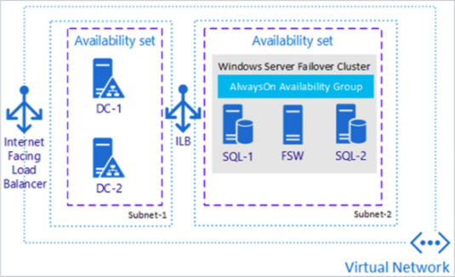
Taking advantage of existing templates
Azure quick-start templates
http://aka.ms/qst
Azure Marketplace (portal)
Examples
SQL Server Always-On Cluster
SharePoint 2013 HA Farm
Preconfigured DC/OS cluster

Slide 8
Demo
Azure Resource Manager templates
Notes:
Open Azure
Show template
Show template deployment

Slide 9
Authoring ARM templates

Slide 10
ARM template structure
{
"$schema": "https://schema.management.azure.com/schemas/2015-01-01/deploymentTemplate.json#",
"contentVersion": "1.0.0.0",
"parameters": {
// Parameters referenced by resources (parameterize your template)
},
"variables": {
// Variables referenced by resources
},
"resources": [
// Virtual Machine, Web App, Virtual Network, SQL Azure, Storage Account, etc.
],
"outputs": {
// Optional outputs from deployment
}
}

Slide 11
Common ARM template functions
concat() – string concatenation
uniqueString() – 64-bit hash of a given string
resourceGroup() – instance of a resource group
resourceId() – unique identifier of a resource
copyIndex() – looping construct
http://aka.ms/armfunc

Slide 12





Using Visual Studio to author ARM templates
Deployment template
Describes the resources to deploy in a resource group
Deployment template parameters
Provides parameter values for parameters defined in the Deployment Template
Deployment script
PowerShell script to deploy the resources defined in the Deployment Template using the parameter values defined in the Deployment Template Parameters file
Deployment template (JSON)
Deployment template parameters (JSON)
Deployment script (PowerShell)

Slide 13
Demo
Author an ARM template using Visual Studio
Notes:
Open VS
Build a template

Slide 14
Deploying ARM templates

Slide 15
Methods for deploying ARM templates
PowerShell
Azure PowerShell Cmdlets 1.0 (or newer) - “AzureRM” cmdlets
Azure Command-Line Interface (CLI)
Cross-platform tools for Mac, Linux, and Windows
Visual Studio
Azure Tools/SDK
Azure portal
Template deployment
Continuous deployment

Slide 16

Deploying ARM templates
Deployment template (JSON)
Deployment template parameters (JSON)
Microsoft Azure
Deployment script (PowerShell)
Azure Subscription
Push Deployment template and parameters to ARM
Resource Group
Resource Group
ARM

Slide 17
Demo: Deploying ARM templates
Notes:
Deploy

Slide 18
Desired State Configuration (DSC)

Slide 19
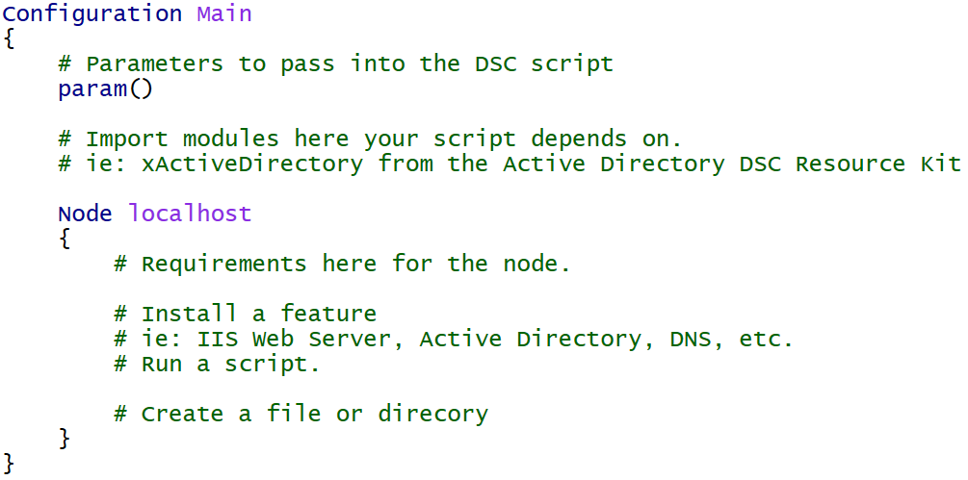
DSC for Azure
Declarative configuration of the virtual machine
Windows Features and Roles
Custom application configuration

Slide 20
DSC Example: Built-in Resources
Configuration Main {
Param ( [string] $nodeName )
Import-DscResource -ModuleName PSDesiredStateConfiguration
Node $nodeName {
WindowsFeature WebServerRole {
Name = "Web-Server"
Ensure = "Present"
}
Package InstallWebDeploy {
Ensure = "Present"
Path = "C:\WindowsAzure\WebDeploy_amd64_en-US.msi"
Name = "Microsoft Web Deploy 3.6"
ProductId = "{ED4CC1E5-043E-4157-8452-B5E533FE2BA1}"
Arguments = "ADDLOCAL=ALL"
}
Service StartWebDeploy {
Name = "WMSVC"
StartupType = "Automatic"
State = "Running"
DependsOn = "[Package]InstallWebDeploy"
}
}
}

Slide 21
DSC Resources
Built-in
WindowsFeature, File, Package, Service, Script, etc.
DSC Resource Kit (~500 resources)
https://blogs.msdn.microsoft.com/powershell/2016/02/11/dsc-resource-kit-gets-even-bigger/
Experimental Resources
xNetworking, xDisk, xSqlServer, xActiveDirectory, etc.
Community Resources
cUserRightsAssignment, cNtfsAccessControl, etc.

Slide 22
DSC Example: Resource-Kit Resources
Configuration Main {
Param ( [string] $nodeName )
Import-DscResource -ModuleName PSDesiredStateConfiguration, xNetworking, cUserRightsAssignment
Node $nodeName {
WindowsFeature DNS {
Ensure = "Present"
Name = "DNS"
}
xDnsServerAddress DnsServerAddress {
Address = "127.0.0.1"
InterfaceAlias = "Ethernet"
AddressFamily = "IPv4"
DependsOn = "[WindowsFeature]DNS"
}
cUserRight GrantIncreaseQuotaPrivilege
{
Ensure = "Present"
Constant = "SeIncreaseQuotaPrivilege"
Principal = "CONTOSO\AdminUser"
}
}
}

Slide 23
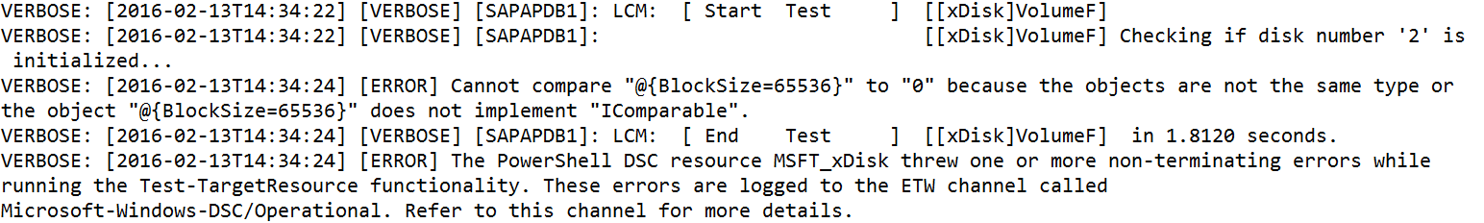
DSC Logs (on the virtual machine)
Provides details on the configuration (script) in the virtual machine
C:\WindowsAzure\Logs\Plugins\Microsoft.Powershell.DSC\<version>

Slide 24
Demo
Desired State Configuration
Notes:
Create a DSC extension
Inspect the DSC
Uncomment the web server sample code
Show the log files
Show the extension in the portal
‘

Slide 25

Questions?

